Slide 1

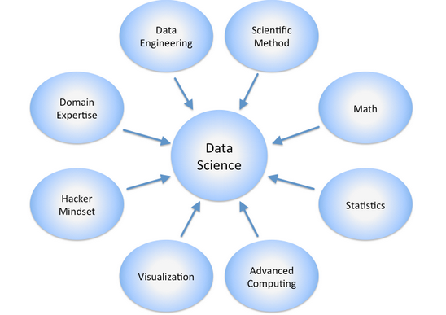

MEDICAL INVENTORY OPTIMIZATION

Slide 2


Project Leadership
Sharat Manikonda
Director at Innodatatics and Sponsor
linkedin.com/in/sharat-chandra

Slide 3
.
NAME: PADMAVATHY.D
https://www.linkedin.com/profilelink

Slide 4

Contents
Project Overview and Scope
Business Problem
Objective, Constraints
CRISP-ML(Q) Methodology
Technical Stacks
Project Architecture
Data Collection and Understanding
Data Information
Data Dictionary
6

Slide 5
System Requirements
Exploratory Data Analysis [EDA]
EDA Description
Missing Values Observation
Data Visualization
Model Building
Model Accuracy Comparison
Model Deployment - Strategy
Screen shot of output
Contents

Slide 6

Project Overview and Scope
The goal of the project is to optimize the inventory of drugs based on number of drugs sold and returned. In this way we can forecast the future and the past. Exploratory data analysis have to be used to achieve the goal. Tableau is used for data visualization and forecasting is done using ML algorithms.
Scope
The project involves optimizing inventory levels, minimizing wastage, and improving supply chain efficiency to reduce costs and ensure that medical supplies are readily available when needed.
7

Slide 7


Business Problem
To do analysis on Medical inventory optimization based on drugs and to Inventory deals with warehouses for the storage of drugs according to the condition of the patients and the number of drugs being sold and returned. By forecasting we can optimize the inventory for future and past .

Slide 8
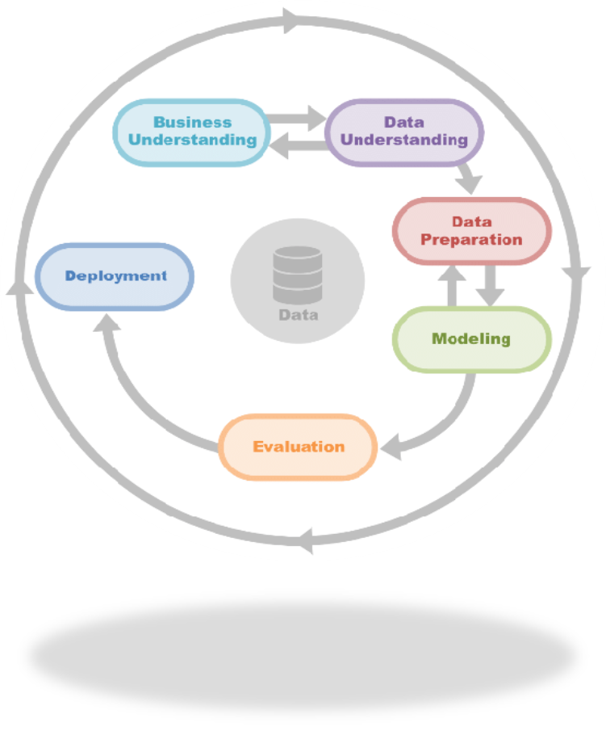
Objective
Minimize Bouncing Rate to Zero
Increasing efficiency and reducing costs
Maximize the Profit
Improving stock management and reducing waste
Enhancing customer satisfaction
Constraints
Data availability and quality
Uncertainty in future events

Slide 9
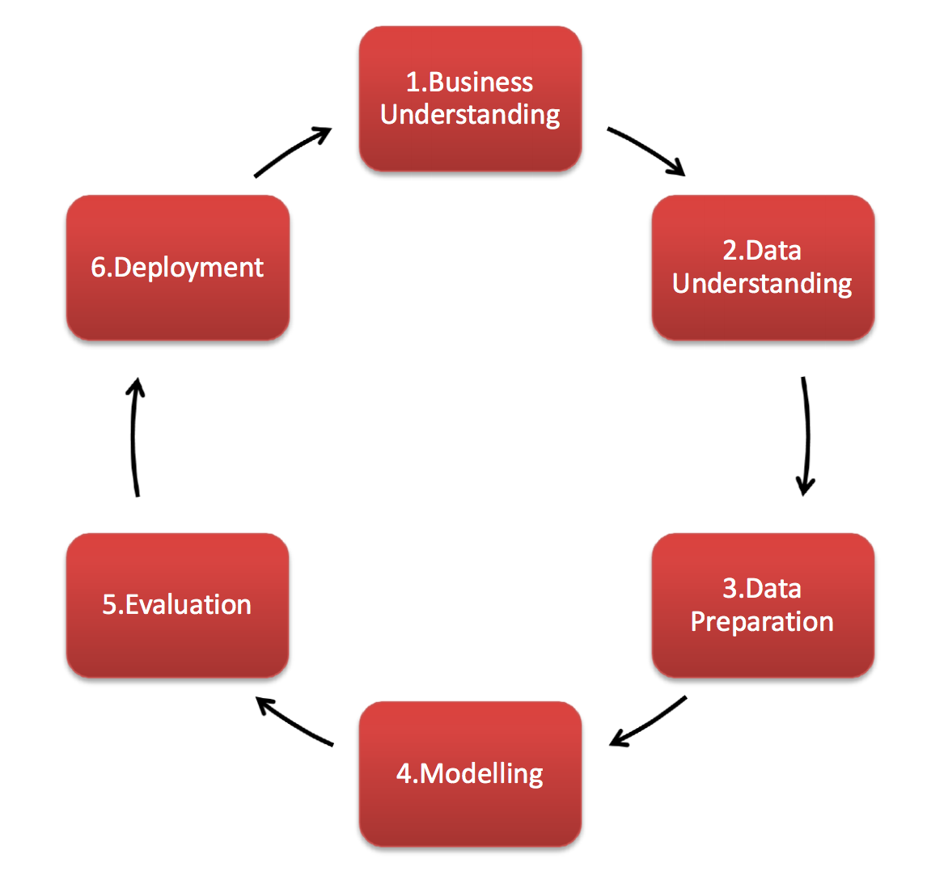
CRISP-ML(Q) Methodology
( 1 ) Business Understanding and Data Understanding
( 2 ) Data Preparation
( 3 ) Model Building
( 4 ) Evaluation
( 5 ) Model Deployment
( 6 ) Monitoring and Maintenance

Slide 10
Technical Stacks
Data Collection : From Client
Data Pre-processing : Pandas, NumPy, ScikitLearn
Model Building : StatsModels
Deployment : Streamlit
Database Management : MySQL
Programming Language : Python, SQL

Slide 11
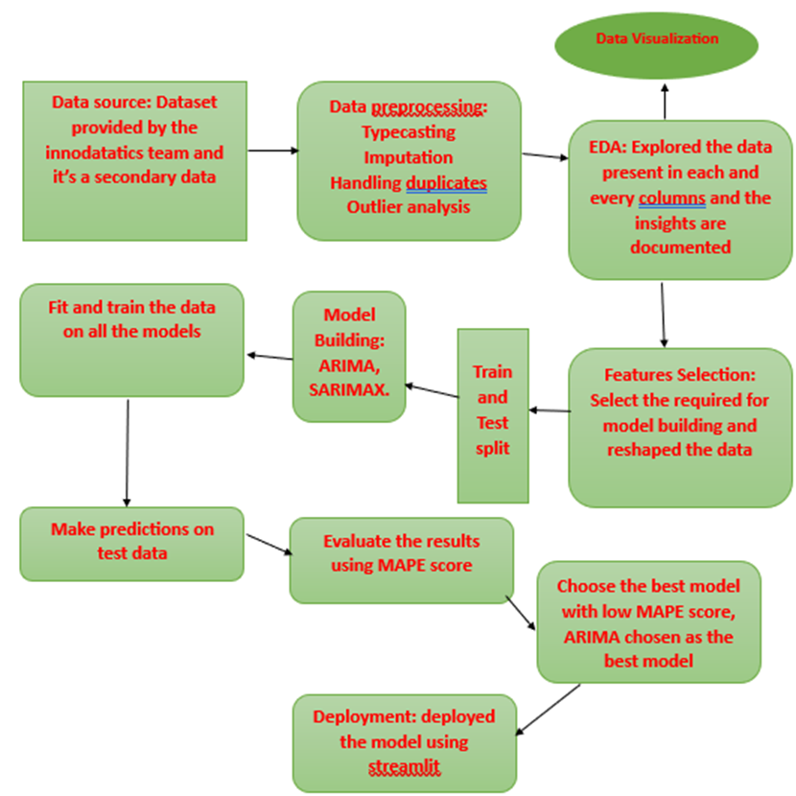
Project Architecture

Slide 12
Data Collection and Understanding
Data Collection Received from the Client
Data Understanding
The data has got 14 columns and 14213 rows
VARIABLE NAME VARIABLE DESCRIPTION
Typeofsales Type of sale of the drug. Either the drug is sold or returned.
Patient_ID ID of a patient
Specialisation Name of Specialisation (eg. Cardiology)
Dept Pharmacy, the formulation is related with.
Dateofbill Date of purchase of medicine
Quantity Quantity of the drug
ReturnQuantity Quantity of drug returned by patient to the pharmacy
Final_Cost Final Cost of the drug (Quantity included)
Final_Sales Final sales of drug
RtnMRP MRP of returned drug (Quantity included)
Formulation Type of formulation
DrugName Generic name of the drug
SubCat Subcategory (Type) to the category of drugs.
SubCat1 Subcategory (condition) to the category of drugs

Slide 13
Data Information
Number Of Columns : 14
Number Of Rows : 14218
Categorical Columns : 7
Numerical Columns : 7

Slide 14
Data Dictionary
VARIABLE NAME VARIABLE DESCRIPTION
Typeofsales Type of sale of the drug. Either the drug is sold or returned.
Patient_ID ID of a patient
Specialisation Name of Specialisation (eg. Cardiology)
Dept Pharmacy, the formulation is related with.
Dateofbill Date of purchase of medicine
Quantity Quantity of the drug
ReturnQuantity Quantity of drug returned by patient to the pharmacy
Final_Cost Final Cost of the drug (Quantity included)
Final_Sales Final sales of drug
RtnMRP MRP of returned drug (Quantity included)
Formulation Type of formulation
DrugName Generic name of the drug
SubCat Subcategory (Type) to the category of drugs.
SubCat1 Subcategory (condition) to the category of drugs

Slide 15
System Requirements
Operating System : Windows 10 or Above
Processor : Intel Core i5 or Higher
RAM : 2 GB or Higher
Hard Disc : 100 GB or Higher
Platforms Used : Python, SQL, Spyder 4.5, TABLEAU
Internet Connection : High Speed Broadband Connection

Slide 16
The EDA is to gain insights into the data that can be used to inform further analysis and modeling. This process involves examining the data for patterns, trends, and outliers, as well as identifying missing values and potential errors in the data First moment Business decision : Measures of Central Tendency -> Mean, Median, Mode Second moment business decision: Measures of Dispersion -> Variance, Standard Deviation, Range Third moment business decision - Skewness Fourth moment business decision - kurtosis
EDA (Exploratory Data Analysis)

Slide 17

EDA Description
FEATURES | First Moment Business decision MEAN MEDIAN MODE | Second moment business decision STANDARD DEVIATION VARIANCE | Third moment business decision | Fourth moment business decision
PATIENT_ID | 1.20180 1.20180 1.20180 | 28102.2 7.897 | -1.366 | 15
QUANTITY | 2.23174 1.0000 1.0 | 5.132 2.633 | 11.341 | 15
RETURN_QUANTITY | 2.9195 0.0000 0.0 | 1.643 2.700 | 17.172 | 15
FINAL_COST | 1.24824 5.3650 49.352 | 464.7 2.160 | 34.508 | 15
FINAL_SALES | 2.34038 8.6424 0.0 | 671.2 4.505 | 21.006 | 15
RETURN_MRP | 2.9126 0.0000 0.0 | 182.2 3.321 | 15.797 | 15
22

Slide 18
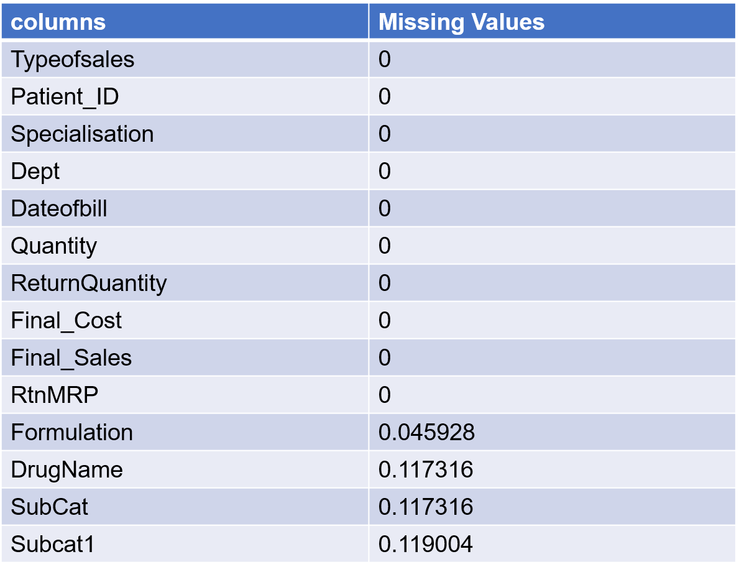
Missing Values Observation
The imputation is done to reduce the missing values

Slide 19
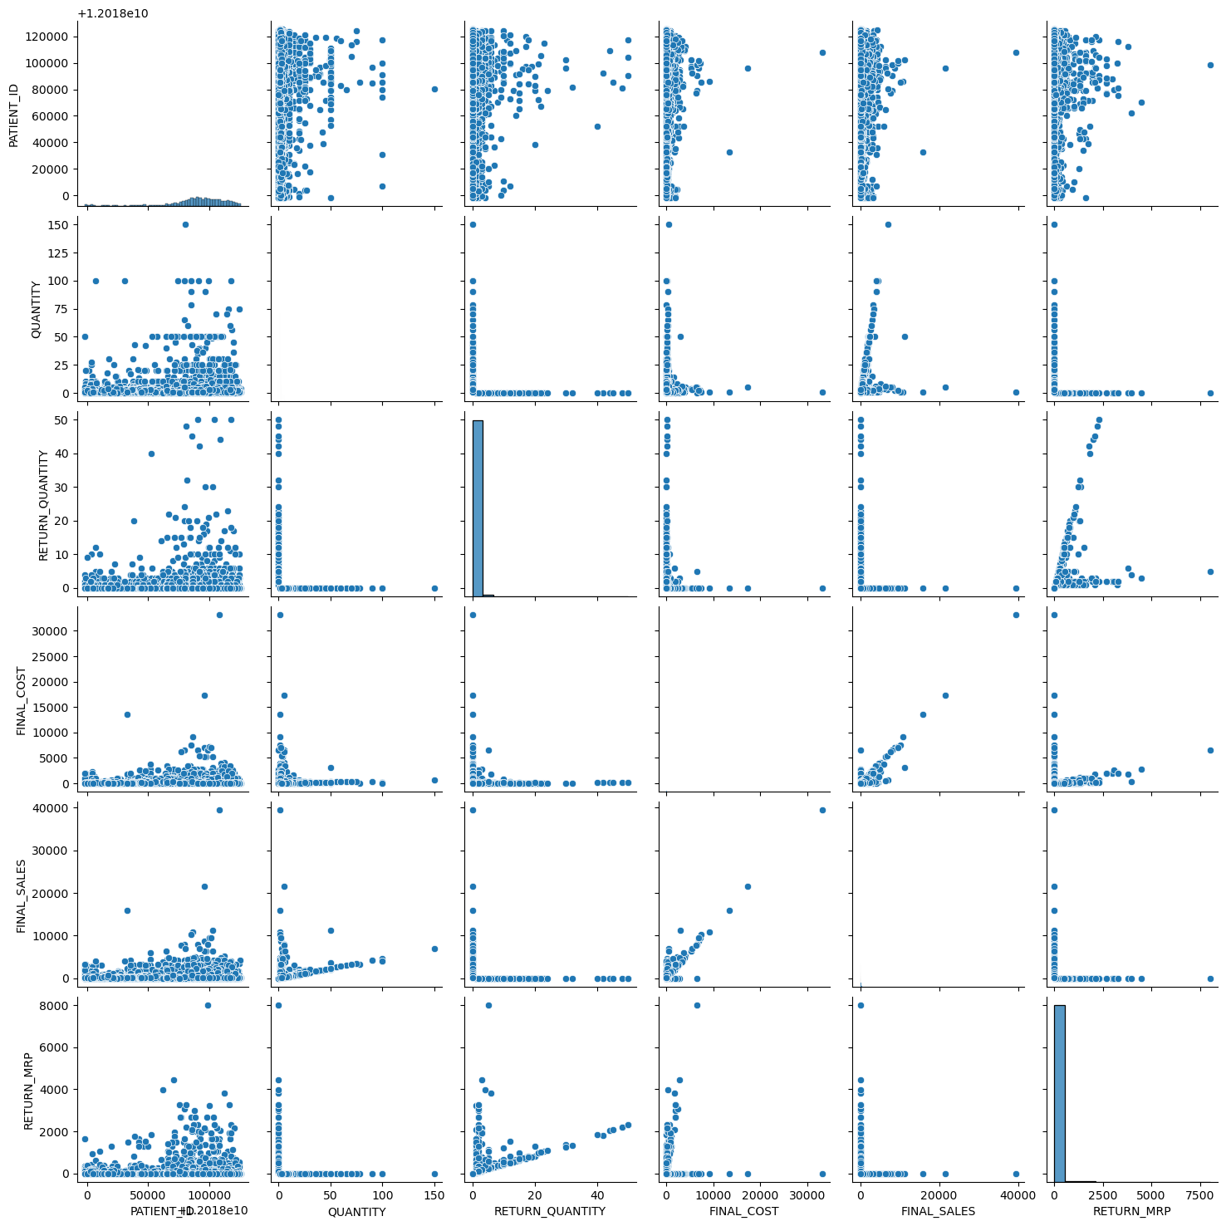
1.By importing the seaborn library we use to see the grid of scatter plots 2.Each plot in the grid shows the relationship between two variables. 3. The variables are plotted on the x and y axis, and each data point in the plot represents the values of the two variables for a single observation in the Data Frame.
Data Visualization

Slide 20
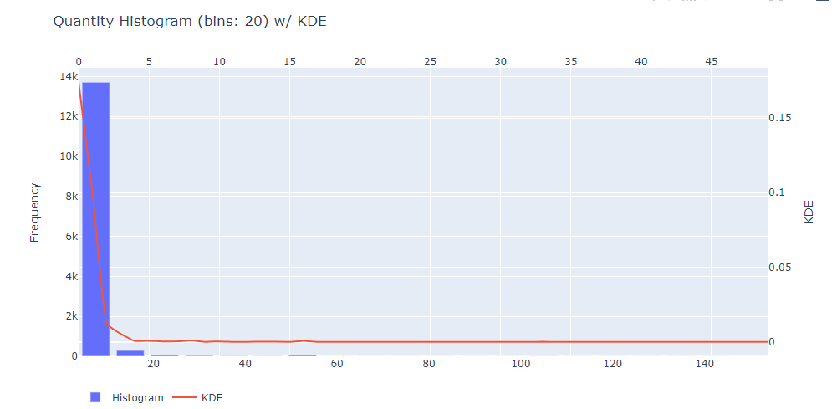
Data Visualization
The histogram represents KDE (Kernel Density Estimation) according to quantity

Slide 21
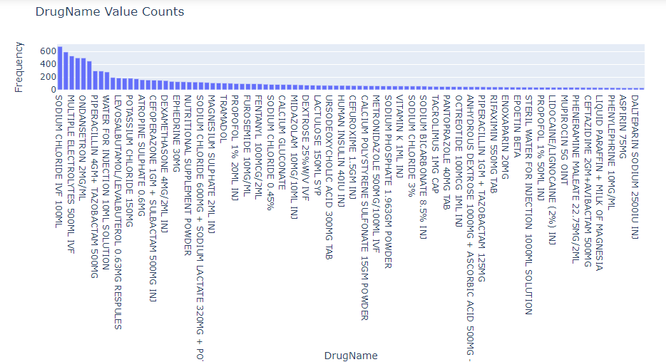
Data Visualization
The histogram represents the value counts of the drug names

Slide 22
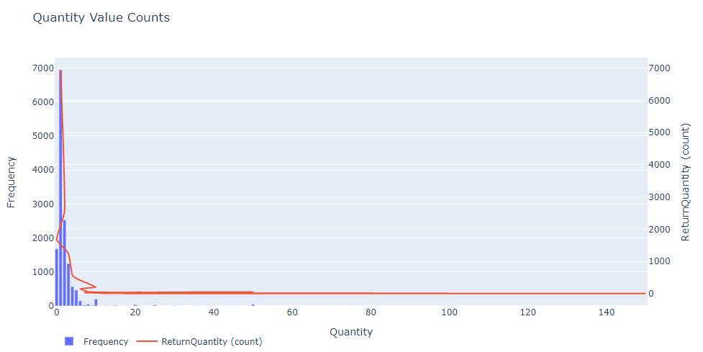
Data visualization Visualization
The histogram represents quantity of value counts and frequency related to the return quantity

Slide 23
Model Building
ARIMA stands for Autoregressive Integrated Moving Average. It is a statistical model used for time series forecasting. The ARIMA model uses past values of the series to predict future values, and it accounts for any trend, seasonality, and other statistical properties of the data.
ARIMA models consist of three main components:
Autoregression (AR) - this component uses past values of the series to predict future values. The autoregressive term refers to the regression of the series on its own past values.
Integrated (I) - this component accounts for the integration of the series, which means that the data has been transformed to be stationary. Stationary data is data that does not have any trend or seasonality.
Moving Average (MA) - this component uses past errors in the series to predict future values. The moving average term refers to the regression of the series on past errors.
ARIMA models can be written as ARIMA(p,d,q), where p is the order of the autoregressive term, d is the degree of differencing (integration), and q is the order of the moving average term. These parameters can be determined through a process called model selection, where the best combination of p, d, and q is chosen based on various statistical measures such as AIC, BIC, and MSE.
ARIMA models can be used for short-term forecasting of time series data and can be extended to forecast long-term trends by incorporating external factors such as economic indicators or demographic data.

Slide 24
SARIMAX (Seasonal Autoregressive Integrated Moving Average with exogenous variables) is an extension of the ARIMA model that takes into account seasonality and external variables. It is a powerful time series forecasting model that is widely used in data science.
Model Building
The SARIMAX model consists of the following components:
Autoregression (AR)
Integrated (I)
Moving Average (MA)
Seasonality
Exogenous variables
The SARIMAX model is often written as SARIMAX(p, d, q)(P, D, Q, s), where p, d, and q are the ARIMA model
The parameters and P, D, Q, and s are the seasonal parameters. The s parameter represents the length of the
seasonal
P, D, and Q parameters are the seasonal counterparts to p, d, and q.
SARIMAX models are widely used in finance, economics, and other fields to forecast time series data.
They are particularly useful for forecasting data with complex seasonal patterns or when there are
external variables that influence the data.

Slide 25
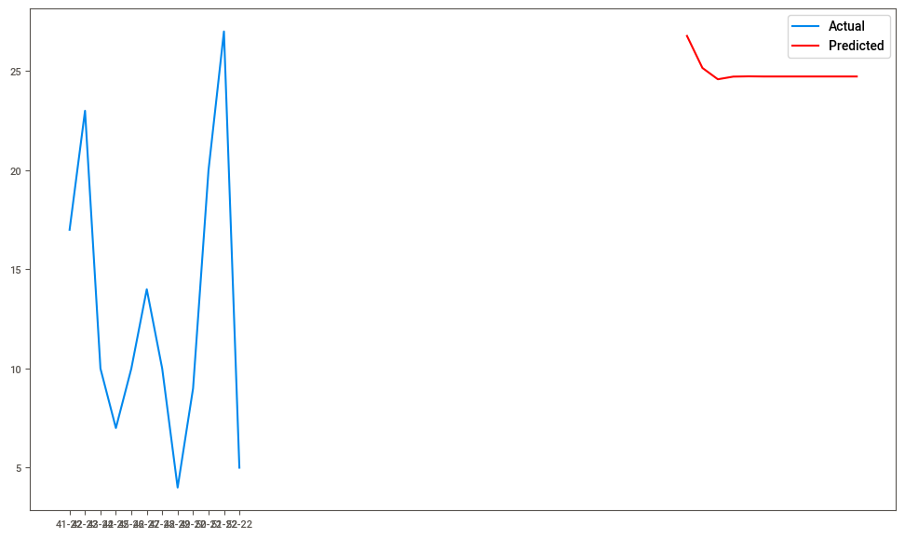
Model Accuracy Comparison - ARIMA
mape : 1.63%

Slide 26
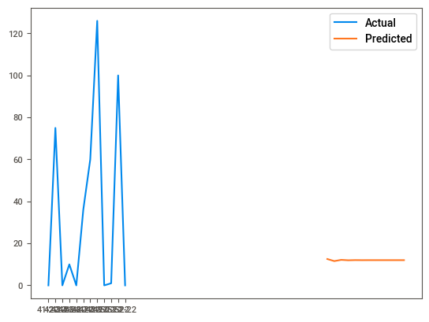
Model Accuracy Comparison - SARIMAX
mape : 0.58%

Slide 27
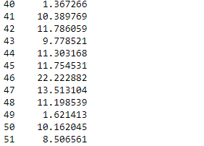
Best Model
ARIMA (Autoregressive Integrated Moving Average) is a popular time series forecasting model that is widely used in various fields such as finance, economics, and engineering.
Its flexibility, accuracy, robustness, and explainability make it the best model for forecasting in many applications.
ARIMA model with top 20 drugs and some values are

Slide 28
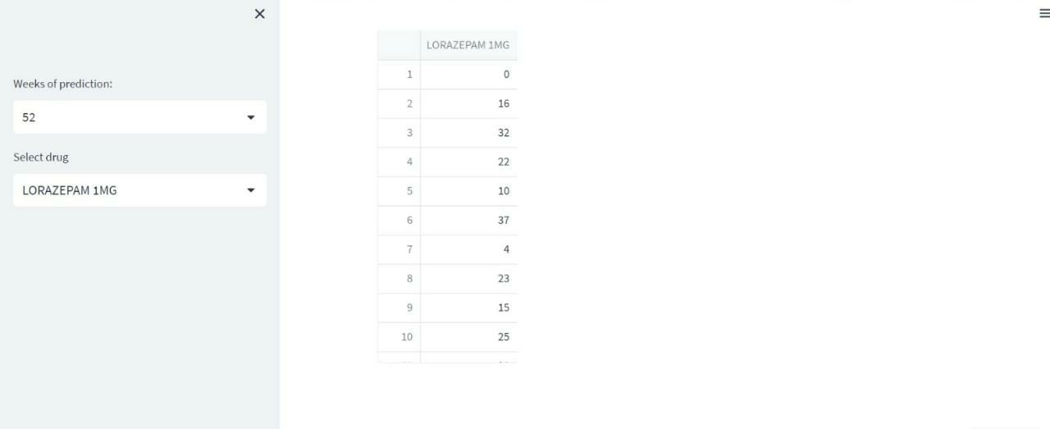
Screen short of output

Slide 29
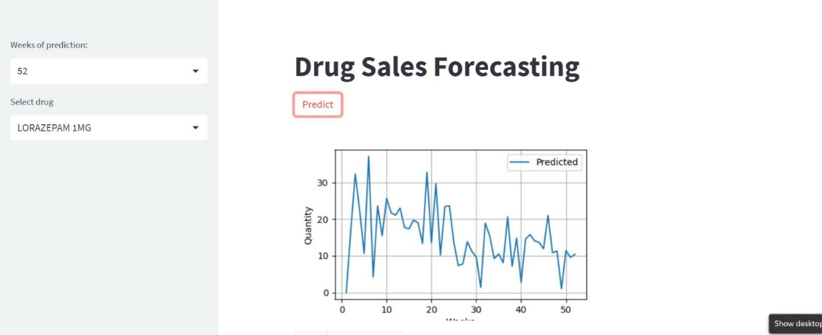
Screen short of output

Slide 30
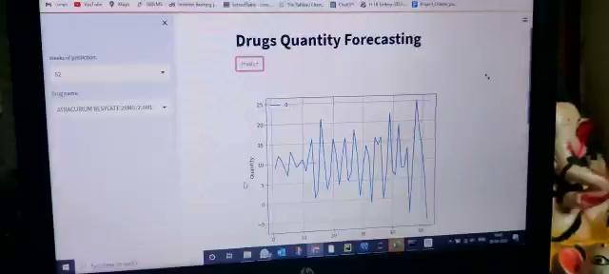
Video of the output

Slide 31
Future Scopes
Predictive analytics: Data science can be used to predict demand for medical supplies and equipment based
on past usage patterns, seasonal trends, and other factors.
By accurately forecasting demand, healthcare providers can optimize their inventory levels and avoid
stockouts or overstocking.
Real-time inventory tracking: Real-time tracking of inventory levels can be accomplished using Iot devices and
sensors. By monitoring inventory levels in real-time, healthcare providers can quickly identify when supplies are
running low and restock before a shortage occurs.
Supply chain management: Supply chain management is an important aspect of medical inventory optimization.
Data science can be used to identify bottlenecks in the supply chain and suggest ways to optimize the flow
of goods and materials.
Cost optimization: Healthcare providers are under pressure to reduce costs while maintaining high-quality care.
Data science can be used to optimize inventory levels and reduce waste, leading to cost savings for
healthcare providers.
Automated ordering: Data science can be used to automate the ordering process for medical supplies
and equipment. By integrating inventory management systems with ordering systems, healthcare providers can
streamline the ordering process and reduce the risk of human error.

Slide 32

Queries ?

Slide 33


